Slide 1

Platform as a Service | PaaS
Dr. Saroja Kumar Rout
Associate Professor, Depatment of IT

Slide 2
Platform as a Service (PaaS)
Platform as a Service (PaaS) provides a runtime environment. It allows programmers to easily create, test, run, and deploy web applications. You can purchase these applications from a cloud service provider on a pay-as-per use basis and access them using the Internet connection.
In PaaS, back end scalability is managed by the cloud service provider, so end- users do not need to worry about managing the infrastructure.
PaaS includes infrastructure (servers, storage, and networking) and platform (middleware, development tools, database management systems, business intelligence, and more) to support the web application life cycle.
Example: Google App Engine, Force.com, Joyent, Azure.

Slide 3
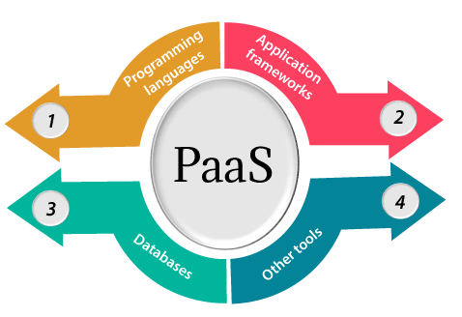
Platform as a Service | PaaS

Slide 4
1. Programming languages
PaaS providers provide various programming languages for the developers to develop the applications. Some popular programming languages provided by PaaS providers are Java, PHP, Ruby, Perl, and Go.
2. Application frameworks
PaaS providers provide application frameworks to easily understand the application development. Some popular application frameworks provided by PaaS providers are Node.js, Drupal, Joomla, WordPress, Spring, Play, Rack, and Zend.
3. Databases
PaaS providers provide various databases such as ClearDB, PostgreSQL, MongoDB, and Redis to communicate with the applications.
4. Other tools
PaaS providers provide various other tools that are required to develop, test, and deploy the applications.

Slide 5
Advantages of PaaS
There are the following advantages of PaaS -
1) Simplified Development
PaaS allows developers to focus on development and innovation without worrying about infrastructure management.
2) Lower risk
No need for up-front investment in hardware and software. Developers only need a PC and an internet connection to start building applications.
3) Prebuilt business functionality
Some PaaS vendors also provide already defined business functionality so that users can avoid building everything from very scratch and hence can directly start the projects only.
4) Instant community
PaaS vendors frequently provide online communities where the developer can get the ideas to share experiences and seek advice from others.
5) Scalability
Applications deployed can scale from one to thousands of users without any changes to the applications.

Slide 6
Disadvantages of PaaS
1) Vendor lock-in
One has to write the applications according to the platform provided by the PaaS vendor, so the migration of an application to another PaaS vendor would be a problem.
2) Data Privacy
Corporate data, whether it can be critical or not, will be private, so if it is not located within the walls of the company, there can be a risk in terms of privacy of data.
3) Integration with the rest of the systems applications
It may happen that some applications are local, and some are in the cloud. So there will be chances of increased complexity when we want to use data which in the cloud with the local data.

Slide 7
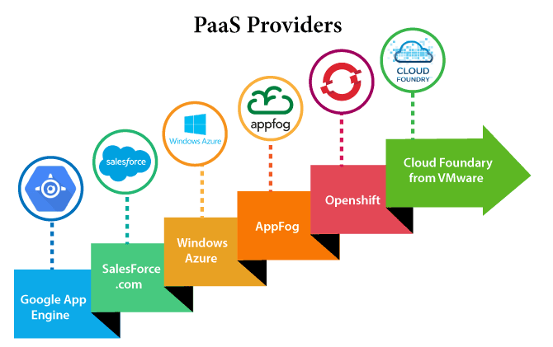

Slide 8
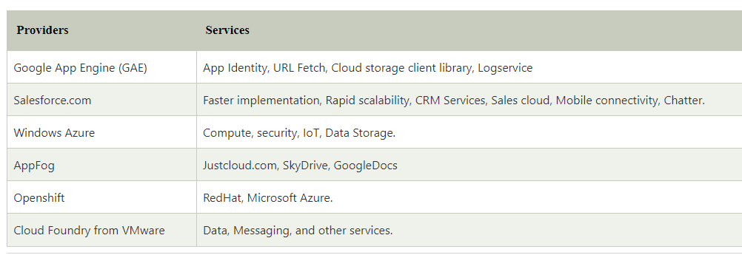

Slide 18
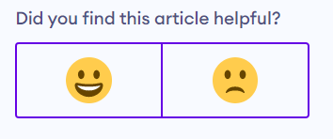

Slide 19


